Slide 1



OPPORTUNITY REVIEW
DIRECT-TO-EMPLOYER GTM STRATEGY
Exploring a MercyOne DTE Health Plan

Slide 2


Founded in 1979, headquartered in Indianapolis
Largest Independently-Owned Full-Service Third-Party Administrator
Specialize in Administration of Self-Funded Plans and Population Health Management​
Leader in the Direct-to-Employer Movement
We Know and Understand the Market
Experience Working with All Professional Teams: Agents, Networks, MGAs
The Key Family of Companies is a Vertically Integrated group of benefit related organizations
3,000+ Corporate Clients
3 Million Members under Management
700 Employees

Slide 3


MARKET LEADER
IN
PRIVATE LABELED
DTE PLANS
Louisville, KY
OneHealth Plan
Cincinnati, OH
TCH Optimal
Bentonville, AR
Northwest Health Plan
Knoxville, TN
East Tennessee Health Plan
Meridian, MS
Affinity Health Plan
Fort Myers, FL
Lee Health Care Partners

Slide 4
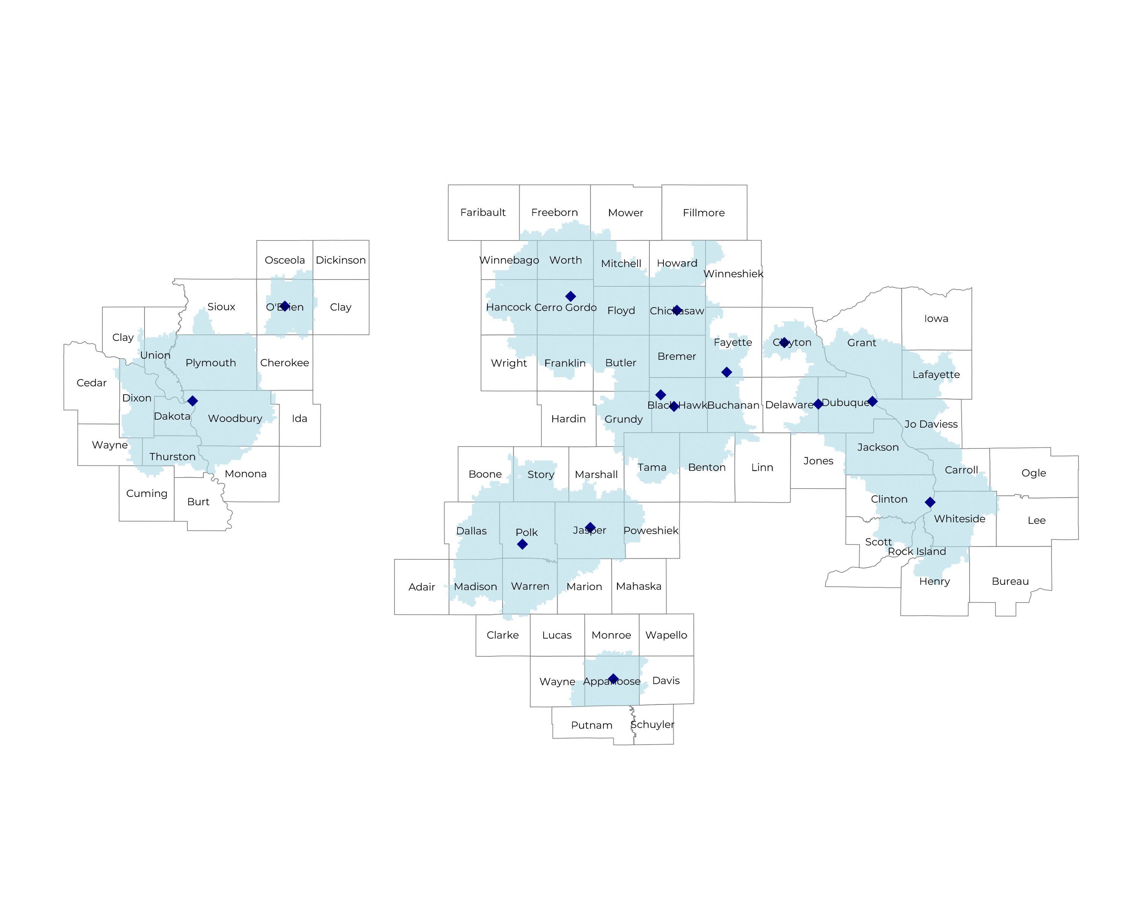
SIGNIFICANT OPPORTUNITY FOR PLAN GROWTH Researched for the below highlighted service area
Target Market 2,000+ Employers 400,000+ Employees 600,000+ Members
 | Employer Size Group (# of Employees)
Commercial Employers With Headquarters | 50-100 | 101-200 | 201-400 | 401-1,000 | 1,001-3,000 | 3,000+
In Catchment Area | 1,079 | 468 | 313 | 191 | 62 | 26
Total Employees at Employers | 50-100 | 101-200 | 201-400 | 401-1,000 | 1,001-3,000 | 3,000+
Headquartered in Catchment Area | 80,900 | 70,200 | 93,900 | 133,700 | 124,000 | 156,000
Total Members with Employers | 50-100 | 101-200 | 201-400 | 401-1,000 | 1,001-3,000 | 3,000+
Headquartered in Catchment Area | 145,600 | 126,400 | 169,000 | 240,700 | 223,200 | 280,800

Slide 5
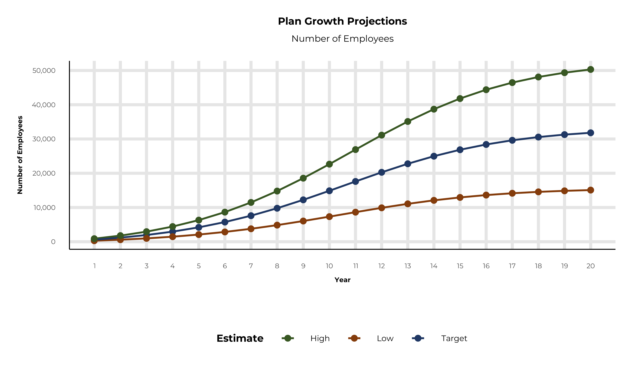
PLAN POTENTIAL GROWTH PATHS
Self Funded
436K
Insured
721K
Working Age
964K
Population
1,664K
Estimates includes the MercyOne service area in Carroll, Henry, Jo Daviess, Rock Island, Whiteside, Appanoose, Benton, Black Hawk, Boone, Bremer, Buchanan, Butler, Cerro Gordo, Chickasaw, Clayton, Clinton, Dallas, Delaware, Dubuque, Fayette, Floyd, Franklin, Grundy, Hancock, Howard, Jackson, Jasper, Linn, Madison, Marion, Marshall, Mitchell, Monona, O'Brien, Plymouth, Polk, Poweshiek, Scott, Sioux, Story, Tama, Warren, Wayne, Winnebago, Woodbury, Worth, Wright, Freeborn, Mower, Dakota, Dixon, Thurston, Clay, Union, Grant, and Lafayette Counties

Slide 6
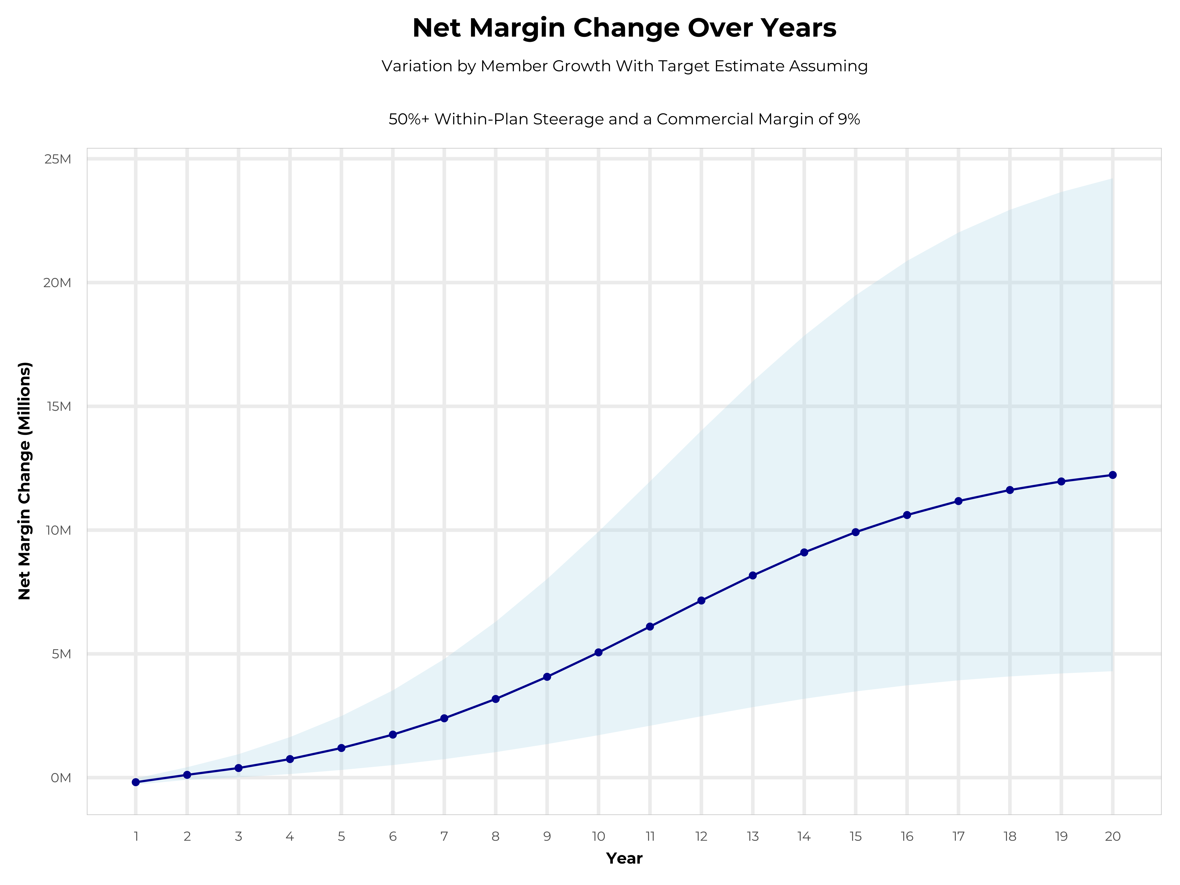
GROWING POWERFUL, LASTING PROFITABILITY
Early Stage
Gaining Name Recognition, Early Growth
New Revenue:
New Profit:
$8.95M
$0.67M
Growth Stage
Strong Reputation, Strong Growth
New Revenue:
New Profit:
$55.34M
$5.16M
Mature Stage
High Profitability, Market Saturation
New Revenue:
New Profit:
$115.84M
$10.94M

Slide 7
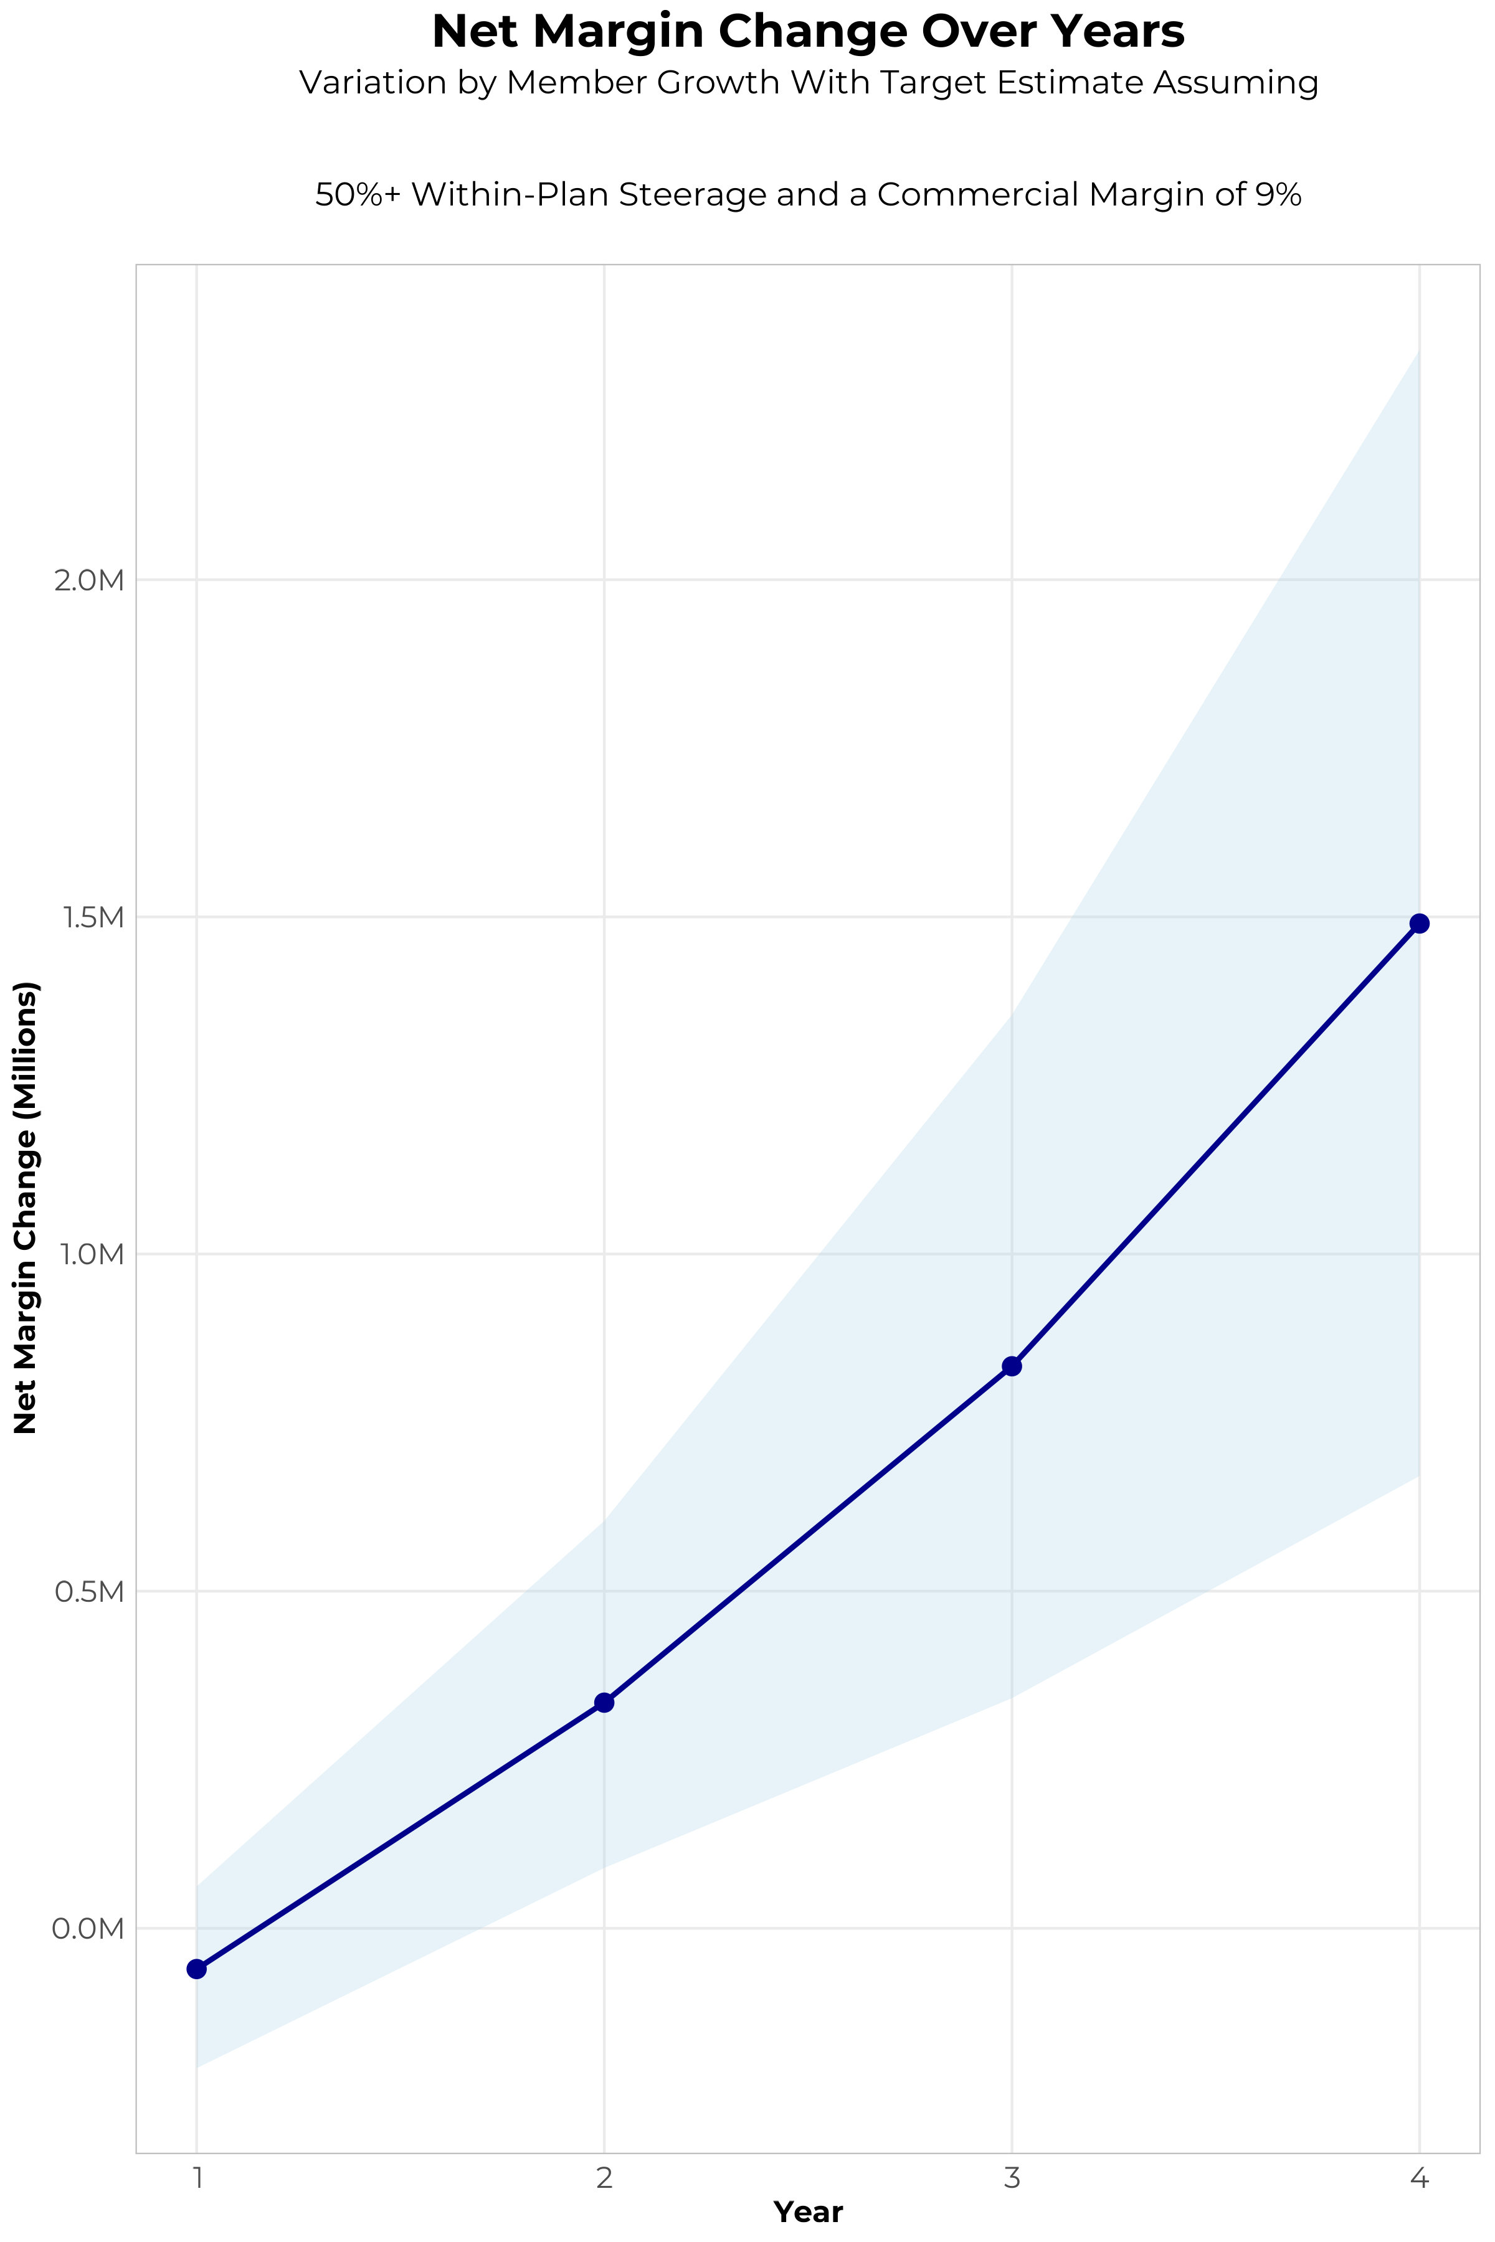
FOUR-YEAR PROJECTIONS
Target Member Growth | Target Member Growth | Target Member Growth | Target Member Growth | Target Member Growth
Metric | Year 1 | Year 2 | Year 3 | Year 4
Number of Members | 1,100 | 2,100 | 3,500 | 5,300
Incremental Margin | 256.4K | 489.4K | 971.5K | 1,606.5K
Network Access Fee | 13.2K | 25.2K | 42.0K | 63.6K
Implementation Fee (One-Time) | -150.0K | 0.0K | 0.0K | 0.0K
Sales and Marketing Costs | -180.0K | -180.0K | -180.0K | -180.0K
Net Margin Change | -60.4K | 334.6K | 833.5K | 1,490.1K
High Member Growth | High Member Growth | High Member Growth | High Member Growth | High Member Growth
Metric | Year 1 | Year 2 | Year 3 | Year 4
Number of Members | 1,600 | 3,200 | 5,300 | 8,000
Incremental Margin | 372.9K | 745.8K | 1,471.1K | 2,424.9K
Network Access Fee | 19.2K | 38.4K | 63.6K | 96.0K
Implementation Fee (One-Time) | -150.0K | 0.0K | 0.0K | 0.0K
Sales and Marketing Costs | -180.0K | -180.0K | -180.0K | -180.0K
Net Margin Change | 62.1K | 604.2K | 1,354.7K | 2,340.9K
Low Member Growth | Low Member Growth | Low Member Growth | Low Member Growth | Low Member Growth
Metric | Year 1 | Year 2 | Year 3 | Year 4
Number of Members | 500 | 1,100 | 1,800 | 2,700
Incremental Margin | 116.5K | 256.4K | 499.6K | 818.4K
Network Access Fee | 6.0K | 13.2K | 21.6K | 32.4K
Implementation Fee (One-Time) | -150.0K | 0.0K | 0.0K | 0.0K
Sales and Marketing Costs | -180.0K | -180.0K | -180.0K | -180.0K
Net Margin Change | -207.5K | 89.6K | 341.2K | 670.8K

Slide 8
YEAR 4 PROJECTED REVENUE AND PROFIT
Pre-DTE Cohort of 5,300 Employees | Inpatient | Outpatient | Professional | Total
Revenue† | $ 5,900,611 | $ 6,347,371 | $ 2,964,168 | $ 15,212,150
Net Income‡ | $ 531,055 | $ 571,263.4 | $ 266,775.1 | $ 1,369,093
† Assuming proportional revenues from market shares of 40% (inpatient) and 24% (outpatient)
‡ Conservatively assuming a commercial margin of 9% (100% of the estimated commercial margin)
With DTE | Inpatient | Outpatient | Professional | Total
Revenue⁰ | $ 9,802,260 | $ 15,373,858 | $ 7,179,461 | $ 32,355,578
Net Income* | $ 882,203.4 | $ 1,383,647 | $ 646,151.5 | $ 2,912,002
⁰ Assuming 67% inpatient and 58% market steerage based on KBA narrow network DTE experience (see previous slide)
* Conservatively assuming a commercial margin of 9%, with a 10 percentage-point reduction to reflect competitive-edge rates and a 10 percentage-point increase due to lower billing costs and higher patient responsibility collections because of the member credit card.
Total Increase in Net Income | $ 1,542,909
Network Access Fee (Revenue) of $1 PMPM | $ 63,600
Total Profit Growth | $ 1,547,709
Minus Implementation Fee (One-Time) | -$ 0
Minus Sales and Marketing (Annual – Ongoing) | -$ 180,000
Total | $ 1,426,509

Slide 9





A PARTNER YOU CAN TRUST
OUR OBJECTIVES ARE ALIGNED
WE KNOW THE
MARKET
COMPLETELY TRANSPARENT
WE HAVE THE SOPHISTICATION AND INFRASTRUCTURE TO EFFECTIVELY COMPETE
Derek Moore, Senior Vice President – KBA
845-283-9973 * derek.moore@keybenefit.com

